Slide 1


Resource Governor SQL Server Enterprise Edition
John Miner Data Architect
john.miner@bluemetal.com
Blog: www.craftydba.com www.mssqltips.com
Tweet: JohnMiner3

Slide 2
Topics covered
Why use the resource governor?
Architectural Overview.
Resource Pools.
Work Groups.
Classification Function.
Monitoring work groups.

Slide 3
Why use the resource governor?
Manage applications in a multi-tenant environment.
Limit the impact of CPU bounded queries.
Reduce the memory foot print of run-away queries.
Manage the I/O of intensive disk bound queries.

Slide 4
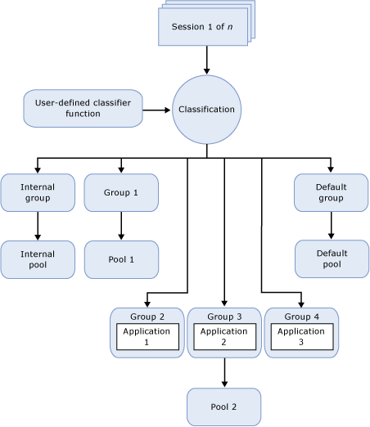
Architectural Overview

Slide 5
Overall process
Enable resource governor.
Create resource pools.
Create work groups.
Create classification function.
Register classification function.
Restart resource governor.

Slide 6
Enabling the resource governor
Either use SSMS or T-SQL.
Open object explorer. Navigate to management. Select the resource governor. Right click and select enable.
Run the following command from [master].
ALTER RESOURCE GOVERNOR RECONFIGURE;
GO

Slide 7
Disabling the resource governor
Either use SSMS or T-SQL.
Open object explorer. Navigate to management. Select the resource governor. Right click and select disable.
Run the following command from [master].
ALTER RESOURCE GOVERNOR DISABLE;
GO

Slide 8
Resource Pools
Default pool accepts all un-classified sessions.
Internal pool is used by the engine.
External resource pool is used by R or Python engines.
There can only be 64 user defined pools per server instance.
Resources can be limited at the pool level.

Slide 9
Workgroups
Act as a container for sessions.
Each workgroup is assigned to one pool.
A pool can have multiple workgroups.
Workgroups can be moved or dropped *.
Used to monitor the aggregate resource usage.
* - all sessions have to be completed before action takes place.

Slide 10
Classification Function
Classify connections into a workgroup name.
The UDF must exist in master database.
Poorly written UDF can cause login issues.
An unclassified connection should map to default workgroup.

Slide 11
Defining the function
A lookup table can be used to map connections to workgroups. Use read uncommitted isolation or (no lock) hint.
The following functions can be used when classifying a connection.
HOST_NAME(), APP_NAME(), SUSER_NAME(), SUSER_SNAME(), IS_SRVROLEMEMBER(), IS_MEMBER(), LOGINPROPERTY(), ConnectionProperty()

Slide 12
Summary
The resource governor can be used to monitor and tune resource usage for applications.
Make sure you have a well written classification function. Otherwise login issues may occur.

Slide 13
References
Enterprise feature only
https://tinyurl.com/mqar3rc
Use limits with resource governor
https://tinyurl.com/y8mhkja7
MSDN pages for resource governor
https://tinyurl.com/y9z68l54
Resource governor DMVs
https://tinyurl.com/y97neard
Example use of resource governor
https://tinyurl.com/y8loe5wv
Login property
https://tinyurl.com/y83awpl4
Connection property
https://tinyurl.com/y8whowh5
Session property
https://tinyurl.com/ybz6znm5
Original database name
https://tinyurl.com/ybhec4jq
Improved classification function
https://tinyurl.com/ydbe228l

Slide 14
Thank You
We look forward to working with you to manage business today and transform the future

